Slide 1
Lecture 9
ETHICAL AND SOCIAL ISSUES IN INFORMATION SYSTEMS (continued)
© Prentice Hall 2011

Slide 2
Learning Objectives
What ethical, social, and political issues are raised by information systems?
What specific principles for conduct can be used to guide ethical decisions?
Why do contemporary information systems technology and the Internet pose challenges to the protection of individual privacy and intellectual property?
How have information systems affected everyday life?
© Prentice Hall 2011
Notes:
Ask students what their first impressions are after seeing these objectives. Can they point to examples of how information systems have affected everyday life? If not, explain that they will be surprised to learn that information systems affect almost every area of daily life. Can students explain how the Internet poses challenges to privacy and intellectual property? Ask them how Google, Facebook, and peer-to-peer networks are related to these issues. What about breakdowns in important networks and software at banks, air traffic control, and other business firms?

Slide 3
The Moral Dimensions of Information Systems
European Directive on Data Protection:
  Requires companies to inform people when they collect information about them and disclose how it will be stored and used.
  Requires informed consent of customer
  EU member nations cannot transfer personal data to countries with no similar privacy protection (e.g. U.S.)
  U.S. businesses use safe harbor framework
    Self-regulating policy to meet objectives of government legislation without involving government regulation or enforcement.
© Prentice Hall 2011
Notes:
EU protections of privacy are far more powerful than the United States because they require informed consent before a firm can do anything with personal information besides support the transaction at hand. In Europe, there is no junk postal mail for instance because advertising firms are prohibited from using personal information obtained from third parties, and without the consent of the individual.

Slide 4
The Moral Dimensions of Information Systems
Internet Challenges to Privacy:
  Cookies
    Tiny files downloaded by Web site to visitor’s hard drive to help identify visitor’s browser and track visits to site
    Allow Web sites to develop profiles on visitors
  Web beacons/bugs
    Tiny graphics embedded in e-mail and Web pages to monitor who is reading message
  Spyware
    Surreptitiously installed on user’s computer
    May transmit user’s keystrokes or display unwanted ads
Google’s collection of private data; behavioral targeting
© Prentice Hall 2011
Notes:
What are students attitudes towards these technologies? Emphasize that cookies can be useful at trusted sites, but perhaps invasive at others. Have students had any experience with spyware or Web bugs on their own computers? Discuss how behavioral targeting amasses information on web users. Ask students why behavioral targeting could pose ethical issues? Can mistakes be made in behavioral targeting? Should private companies own more personal data on individuals than governments? Should the government keep track of what personal private information firms collect?

Slide 5
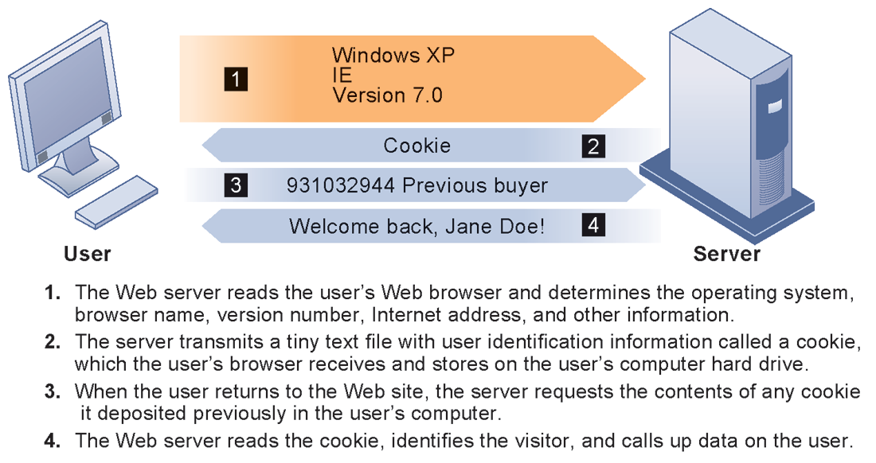
The Moral Dimensions of Information Systems
HOW COOKIES IDENTIFY WEB VISITORS
FIGURE 4-3
Cookies are written by a Web site on a visitor’s hard drive. When the visitor returns to that Web site, the Web server requests the ID number from the cookie and uses it to access the data stored by that server on that visitor. The Web site can then use these data to display personalized information.
© Prentice Hall 2011
Notes:
Ask students to pinpoint where potential privacy invasions might occur in the process shown above. Students may suggest that no real privacy violation is occurring in the figure, which is a legitimate point of view. If so, ask them how they might feel about a Web site they did not trust engaging in the displayed process.

Slide 6
The Moral Dimensions of Information Systems
U.S. allows businesses to gather transaction information and use this for other marketing purposes
Online industry promotes self-regulation over privacy legislation
However, extent of responsibility taken varies
  Statements of information use
  Opt-out selection boxes
  Online “seals” of privacy principles
Most Web sites do not have any privacy policies
© Prentice Hall 2011
Notes:
Do students believe that businesses should be pressed to provide more comprehensive privacy protections online? Explain that businesses prefer the looser regulation, but that individuals may not. Also emphasize that most individuals do not take the proper steps to ensure their own privacy in any case. Most people do not know how to protect their privacy online. Does that mean that privacy is unimportant or that people don’t care?

Slide 7
The Moral Dimensions of Information Systems
Technical solutions
  The Platform for Privacy Preferences (P3P)
    Allows Web sites to communicate privacy policies to visitor’s Web browser – user
    User specifies privacy levels desired in browser settings
    E.g. “medium” level accepts cookies from first-party host sites that have opt-in or opt-out policies but rejects third-party cookies that use personally identifiable information without an opt-in policy
© Prentice Hall 2011
Notes:
Explain that P3P is a standard of privacy intended to provide Web surfers more information about the sites they visit. Also explain that P3P is not universal, and that many sites are not members of the World Wide Web Consortium, which uses P3P.

Slide 8
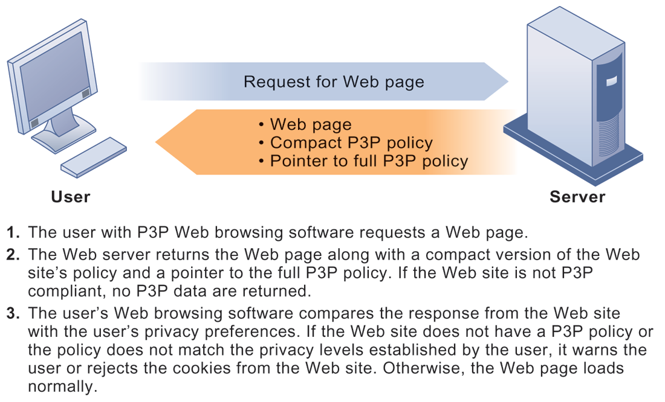
The Moral Dimensions of Information Systems
THE P3P STANDARD
FIGURE 4-4
P3P enables Web sites to translate their privacy policies into a standard format that can be read by the user’s Web browser software. The browser software evaluates the Web site’s privacy policy to determine whether it is compatible with the user’s privacy preferences.
© Prentice Hall 2011
Notes:
Have students configured their own privacy preferences in such a way that they see messages like this at any point? If not, do they care? Are they concerned about the privacy policies of any of the sites they visit? (Students may be reluctant to answer this question!)

Slide 9
The Moral Dimensions of Information Systems
Property rights: Intellectual property
  Intellectual property: Intangible property of any kind created by individuals or corporations
  Three main ways that protect intellectual property
    Trade secret: Intellectual work or product belonging to business, not in the public domain
    Copyright: Statutory grant protecting intellectual property from being copied for the life of the author, plus 70 years
    Patents: Grants creator of invention an exclusive monopoly on ideas behind invention for 20 years
© Prentice Hall 2011
Notes:
Do students believe that the property rights guaranteed by trade secrets, copyrights, and patents are strong enough to avoid the theft of intellectual property online? Give an example of a trade secret (the formula for Coke; a method of doing business or business process). Give an example of a copyright (which could include the copyright of an online business process like Amazon’s One Click shopping). And give an example of a patent.

Slide 10
The Moral Dimensions of Information Systems
Challenges to intellectual property rights
  Digital media different from physical media (e.g. books)
    Ease of replication
    Ease of transmission (networks, Internet)
    Difficulty in classifying software
    Compactness
    Difficulties in establishing uniqueness
Digital Millennium Copyright Act (DMCA)
  Makes it illegal to circumvent technology-based protections of copyrighted materials
© Prentice Hall 2011
Notes:
Students may be unwilling to admit to infringing upon intellectual property rights themselves, but ask them whether they are familiar with the Internet and its ability to bypass intellectual property protections. Do they believe that legislation like the DMCA is having any effect? How many have friends who download “free” music from P2P sights? Free videos?

Slide 11
The Moral Dimensions of Information Systems
Accountability, Liability, Control
  Computer-related liability problems
    If software fails, who is responsible?
      If seen as part of machine that injures or harms, software producer and operator may be liable
      If seen as similar to book, difficult to hold author/publisher responsible
      What should liability be if software seen as service? Would this be similar to telephone systems not being liable for transmitted messages?
© Prentice Hall 2011
Notes:
Using the example from the text, who do students consider to be the liable party for the incident involving TD Bank customers whose paychecks were denied due to an operating error at the bank’s computer center? Is it the designers of the systems at the center? The bank itself as a corporate entity? Is there no liability involved? If there is no liability, why would TD Bank try to prevent these events in the future? Explain that it is difficult to ascribe liability to software developers for the same reason that it is difficult to ascribe a publisher liability for the effects of a book. Does this analogy hold true? There are no guarantees that either books or software are fool proof. When the advice in books is followed, or software used, either could kill you.

Slide 12
The Moral Dimensions of Information Systems
System Quality: Data Quality and System Errors
  What is an acceptable, technologically feasible level of system quality?
    Flawless software is economically unfeasible
  Three principal sources of poor system performance:
    Software bugs, errors
    Hardware or facility failures
    Poor input data quality (most common source of business system failure)
© Prentice Hall 2011
Notes:
Do students have any opinion about when software is ‘good enough?’ Does it depend on the particular product? For example, distinguish between software used by air traffic controllers and software used for word processing. Do students believe that there are different levels of acceptable quality for these products?

Slide 13
The Moral Dimensions of Information Systems
Quality of life: Equity, access, and boundaries
  Negative social consequences of systems
    Balancing power: Although computing power decentralizing, key decision-making remains centralized
    Rapidity of change: Businesses may not have enough time to respond to global competition
    Maintaining boundaries: Computing, Internet use lengthens work-day, infringes on family, personal time
    Dependence and vulnerability: Public and private organizations ever more dependent on computer systems
© Prentice Hall 2011
Notes:
Ask students whether they have witnessed any of these negative consequences first-hand. It’s likely that they know someone who has become dependent on their computer to some extent or have even experienced something similar first-hand. Which of the above consequences do students feel is the most alarming?

Slide 14
The Moral Dimensions of Information Systems
Computer crime and abuse
  Computer crime: Commission of illegal acts through use of compute or against a computer system – computer may be object or instrument of crime
  Computer abuse: Unethical acts, not illegal
    Spam: High costs for businesses in dealing with spam
Employment:
  Reengineering work resulting in lost jobs
Equity and access – the digital divide:
  Certain ethnic and income groups in the United States less likely to have computers or Internet access
© Prentice Hall 2011
Notes:
Ask students what their experience with spam is. A notable statistic is that spam accounts for over 90 percent of all business e-mail traffic and is relatively unlikely to decrease, because it is so difficult to regulate and so cheap to send. Do students believe that the end result of continuing advances in information technology will be rising unemployment and a small number of elite corporate professionals? Students may enjoy debating this idea, which is somewhat far-fetched, but conceptually stimulating.

Slide 15
Summary
Infrormation Systems and their issues
Ethical Issues related to Information Systems
Rules, policies and risks related to IS
How to identify and handle problems
Models to identify ethical issues in information systems.
© Prentice Hall 2011

